Slide 1
Search Engine Marketing
Dr. Avinash Panwar

Slide 2
What is search engine marketing?
The practice of marketing a business using paid advertisements that appear on search engine results pages.
Advertisers bid on keywords that users of services such as Google and Bing might enter when looking for certain products or services.
It gives the advertiser the opportunity for their ads to appear alongside results for those search queries.
Also known by the term pay-per-click ads
Come in a variety of formats. Some are small, text-based ads, whereas others, such as product listing ads (PLAs, also known as Shopping ads) are more visual, product-based advertisements that allow consumers to see important information at-a-glance, such as price and reviews.

Slide 3
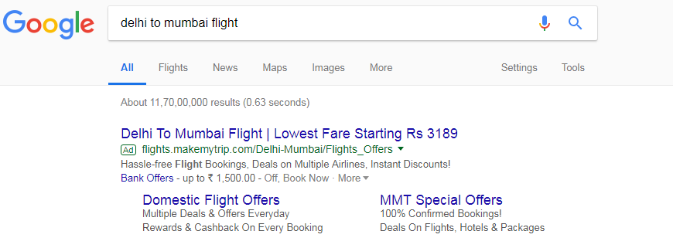
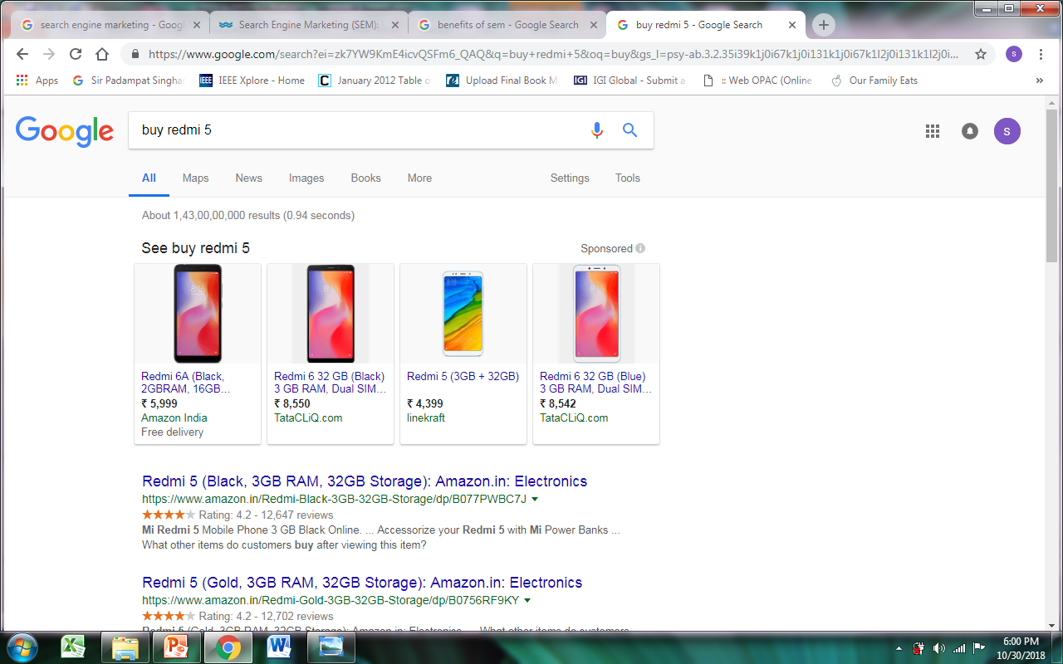

Slide 4
Difference between SEO and SEM
“Search engine marketing" refers to paid search marketing, a system where businesses pay Google to show their ads in the search results.
Search engine optimization, or SEO, is different because businesses don't pay Google for traffic and clicks; rather, they earn a free spot in the search results by having the most relevant content for a given keyword search.

Slide 5
Benefits of SEM
It offers advertisers the opportunity to put their ads in front of motivated customers who are ready to buy at the precise moment they’re ready to make a purchase.
Increase brand awareness and brand equity of product.
Increase Visibility - Increase in web site traffic.
Increase in targeted leads.
Target your ads to users based on languages and locations.
Greater ROI — Compared to other advertising media, paid search strategies are more efficient.

Slide 6
Keyword Research : Foundation of Search Engine Marketing
Keyword research: to find and research actual search terms that people enter into search engines.
Finding keywords that have a decent search volume, but less competition.
Objectives:
To attract organic search traffic.
To maximize the impact of search engine marketing efforts.
Deliverables:
Helps to understand following:
What your audience’s main problems are
The language they use
Which topics are becoming more important or less important over time.

Slide 7
Keyword research methodology
1. Identify the niche topic
A Niche Topic is a topic that your target customer is interested in- not the exact keywords, it’s a broad topic.
Strategy examples:
Identify the buyer persona: (Gender, Age, Approximate income, Hobbies and interests, Things that they struggle with, What they want to accomplish (personally and professionally))
Could be several (e.g. parents and children)
Find forums where your target audience reaches out
Wikipedia Table of Contents

Slide 8
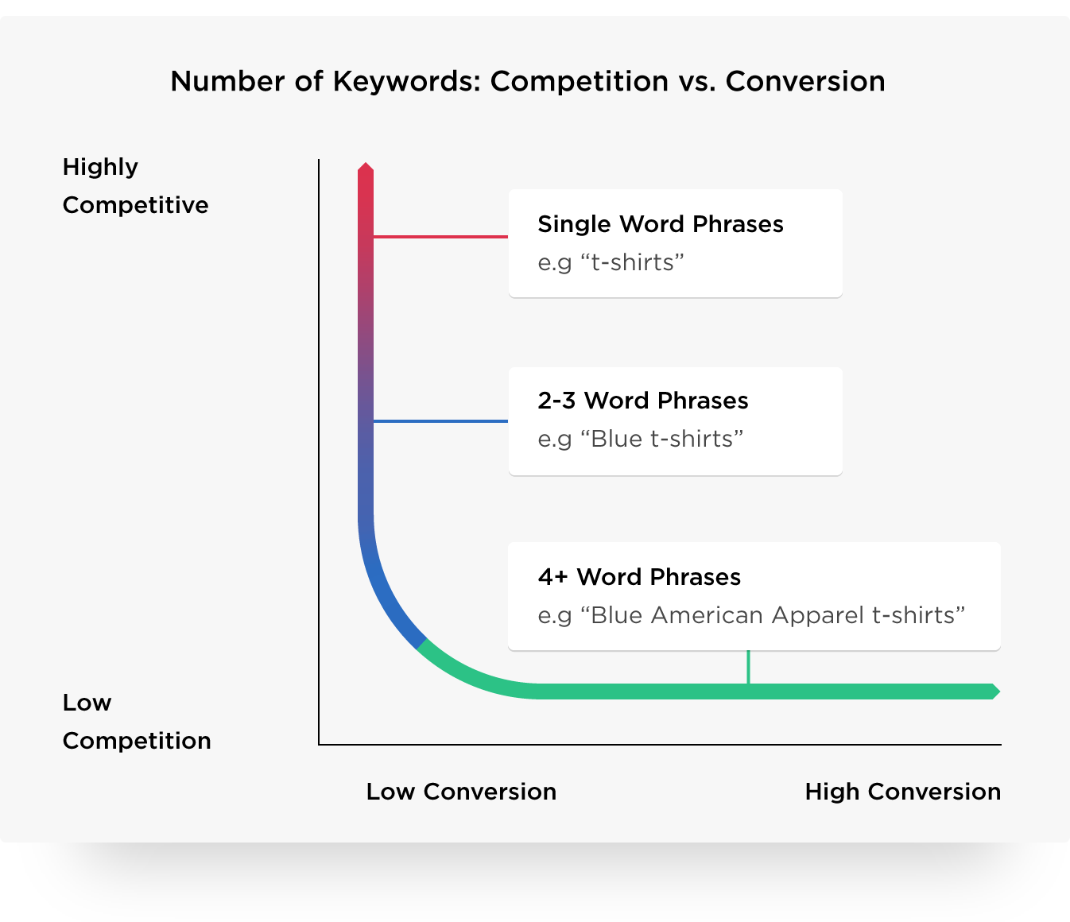
Keyword research methodology
2. Find the keywords
3 main categories: Head, body and tail(long)
Source: https://backlinko.com/keyword-research

Slide 9
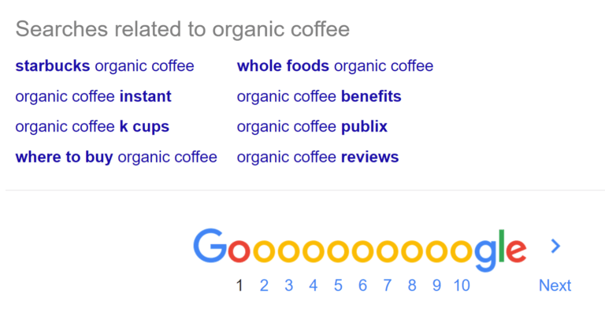
Keyword research methodology
3. Research related search terms.
Go to Google.com and take a look at the related search terms that appear when you plug in a keyword.(useful to find long tail keywords)
4. See how competitors are ranking for these keywords.

Slide 10

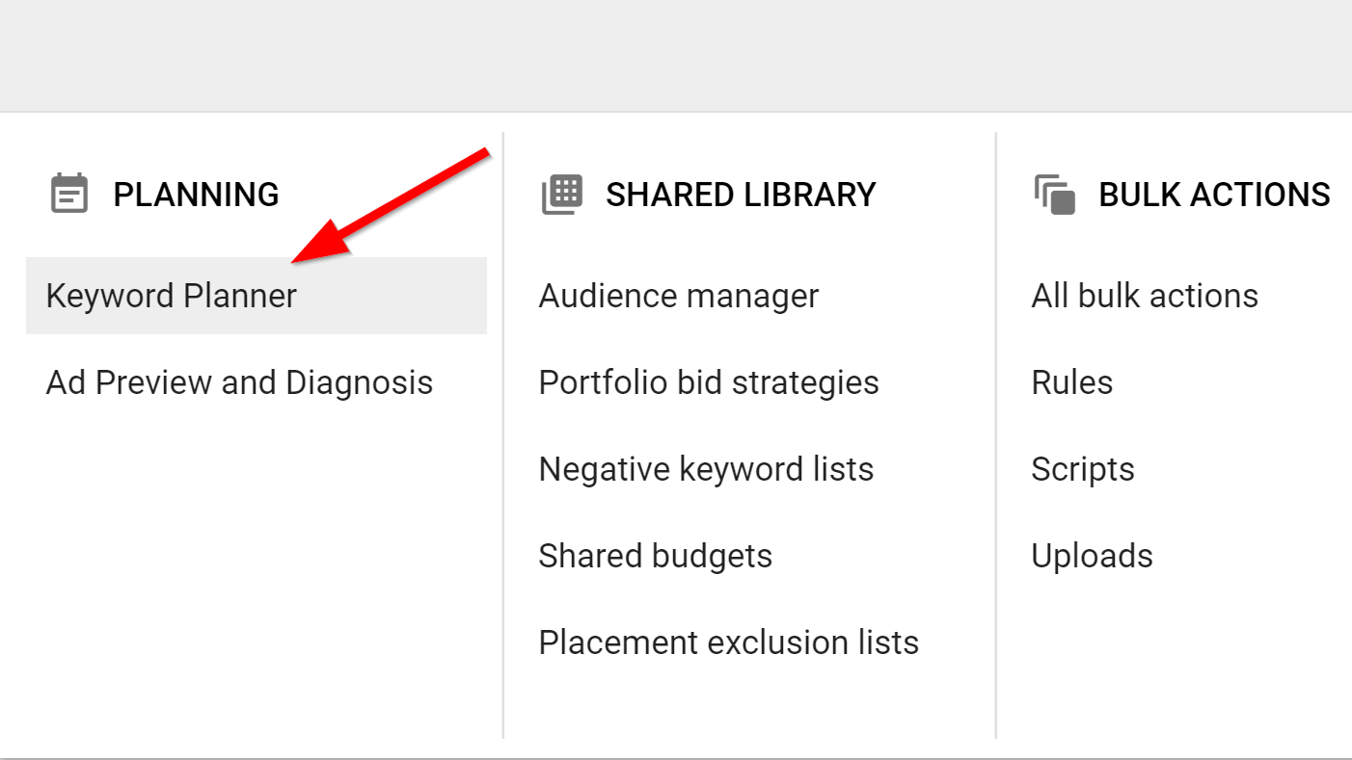
Keyword research methodology
5. Use tools such as Google’s Keyword Planner
Login to Google Ads account →
Find New Keywords
Get search volume and forecasts

Slide 11
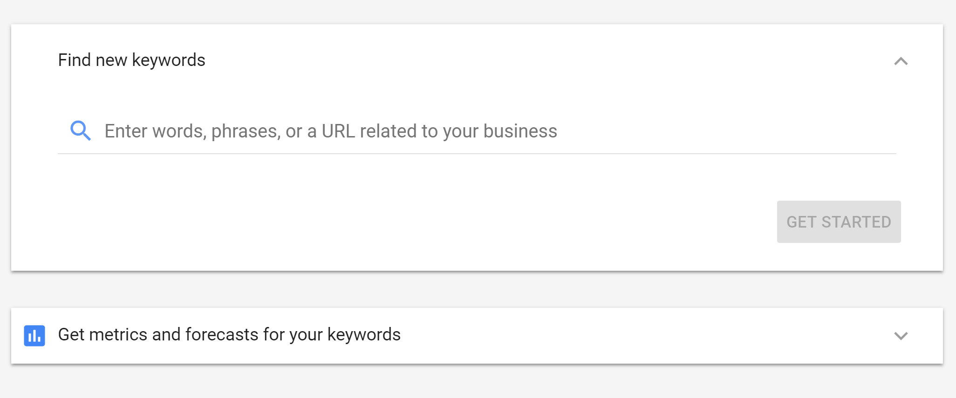
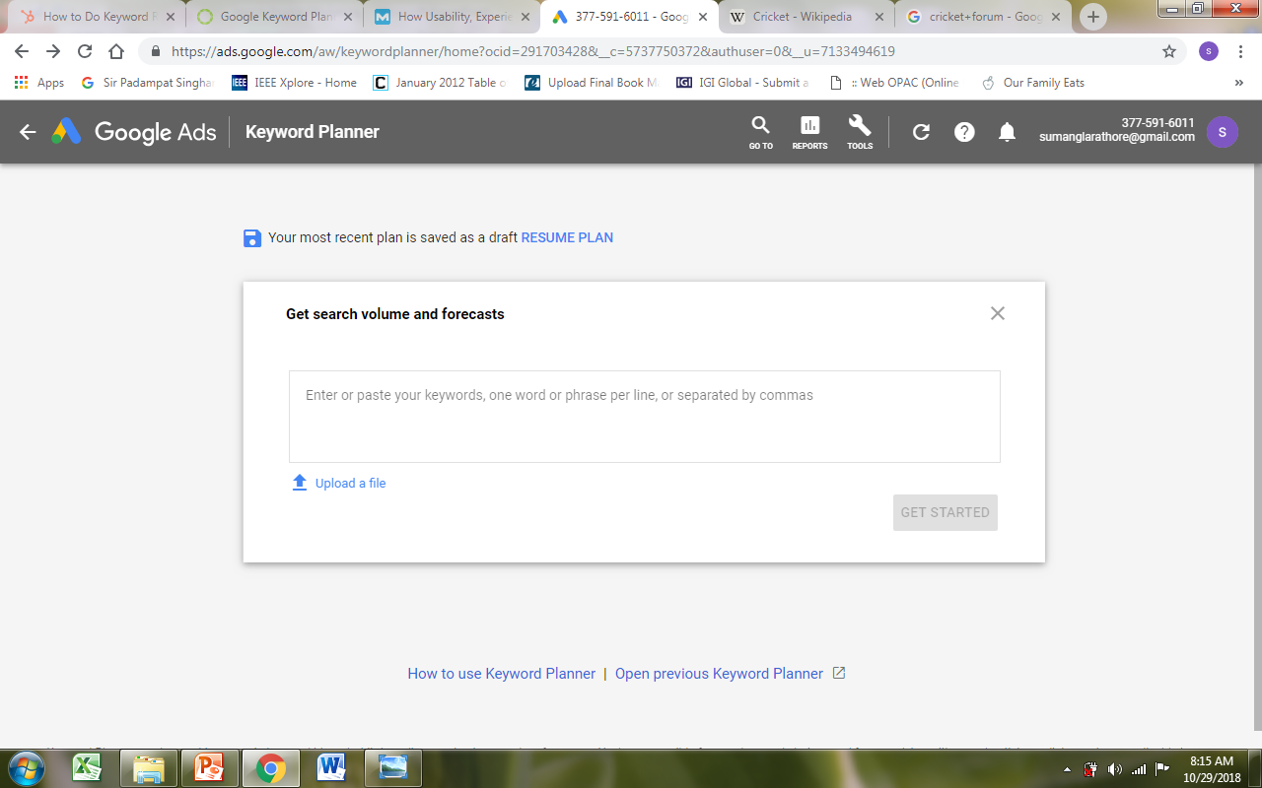

Slide 12
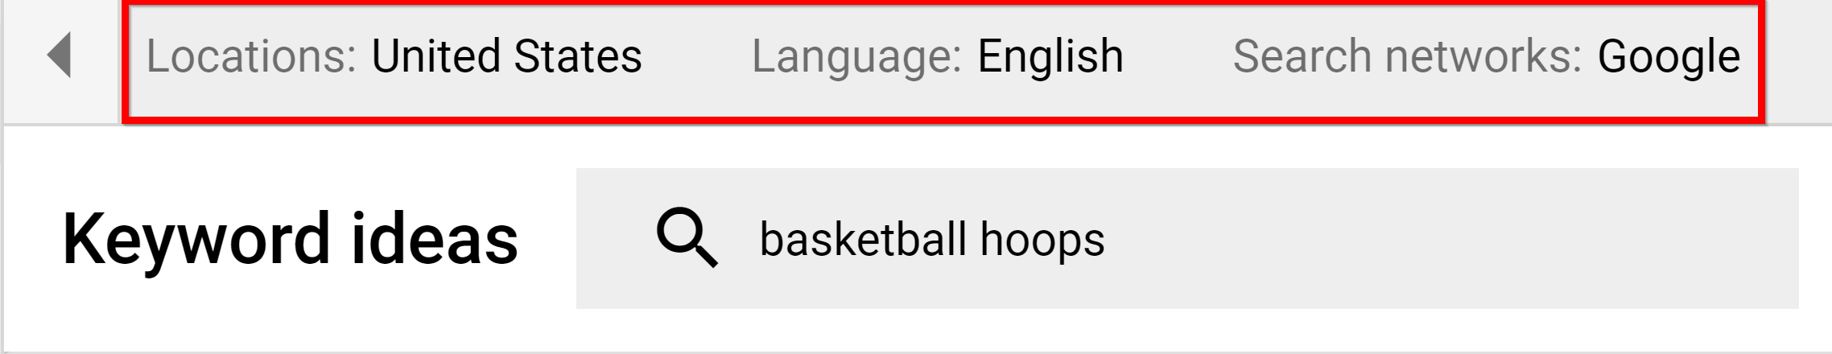
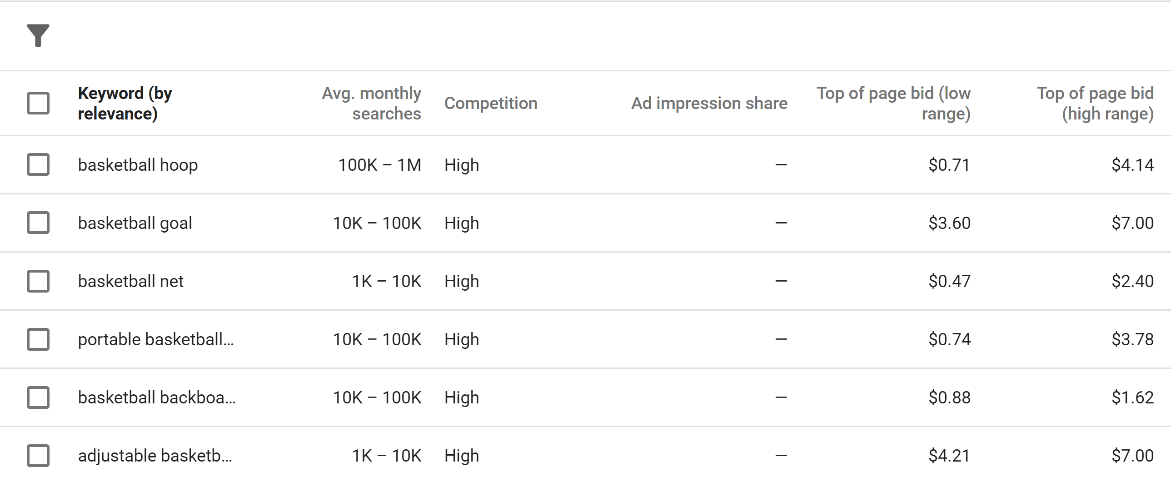

Slide 13
Understanding the Keyword Planner results
Keyword (by relevance): This is the list of keywords that Google considers most relevant to the keyword or URL you typed into it.
Avg. monthly searches: This is range…and not a very accurate indicator of search volume.
Competition: This reflects the number of advertisers bidding on that keyword.
Top of Page Bid: The higher bid here, the more lucrative the traffic.

Slide 14
Keyword research methodology
6. Other Tools
Find Q&A Keywords With Answer The Public
Google Trends
Google Correlate
Quora

Slide 15
Commercial Intent: The Four Keyword Classes
Intent: the likelihood that a prospect will complete a purchase or other desired action after searching for a given term.
Buy Now Keywords – High Conversion rates
Buy
Coupon
Discount
Deal
Shipping
Product Keywords – Early stage in buying cycle
Review
Best
Top 10
Specific brand name (“Nike” or “Toshiba”)
Specific product (“Macbook Pro” or “Samsung Galaxy”)
Product category (“Wordpress hosting” or “tennis shoes”)
Cheap
Affordable
Comparison
Informational keywords - people looking for information
How to
Best way to
Ways to
I need to
Kicker keywords - VERY unlikely to convert
Free
Torrent
Download, …for free

Slide 16
Google Ads vs Microsoft’s Bing Ads
Both are pay-per-click advertising platforms designed to help businesses reach specific audiences, drive traffic, and increase revenue.
 | Google Ads | Bing Ads
Networks | Comprised of two advertising networks: Search and Display | Three search engines — Bing, Yahoo, and AOL
Text Ad format | Three headlines(30 characters each) Display URL Two descriptions (90 characters each) | Three titles (30 characters each) Display URL Upto two Descriptions(90 characters)
Display URL | display URLs underneath the ad headline. Not Bold formatted | display URLs underneath the ad headline. Bold formatted
Keyword research tool | Yes | Yes
Click Through Rate | Higher for most of the verticals | Higher for shopping and financial services search verticals.
Reach and search volume | High | Low
Cost and competition | High CPC and high competition | Cheaper CPC and low competition
Campaign and Ad group level control | Allows settings at campaign level | Allows settings at Ad-group level

Slide 17
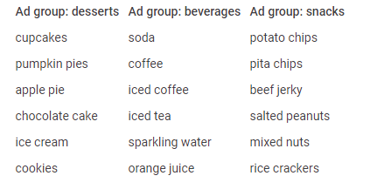
What is a campaign?
Ad campaigns: focus on similar products or services, A set of ad groups (ads, keywords, and bids) that share a budget, location targeting, and other settings that determine where your ads appear.
Ad groups: allow each campaign to be further subcategorized for relevance
An ad group contains one or more ads which target a shared set of keywords.
It is helpful to base ad groups on the sections or categories that appear on the website. For example, let's say you sell desserts, beverages, and snacks on your website.

Slide 18
Types of campaigns
Campaign type determines where customers will be able to see your ads.
Search campaigns | Text ads on search results
Display campaigns | Image ads on websites
Video campaigns | Video ads on YouTube
Shopping campaigns | Product listings on Google
App campaigns | Promote your app on many channels
Local campaigns | Promote locations on many channels
Smart campaigns | Automate your campaigns
Discovery| Personalized ads that drive engagement with your brand across YouTube, Gmail, Discover, and more

Slide 19
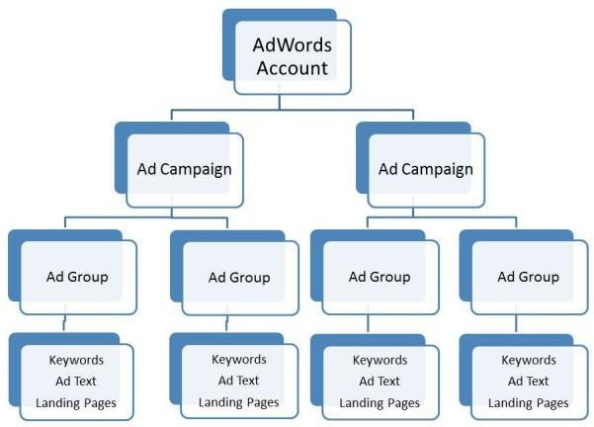
Ad groups and keyword setup
This level of organization might take slightly longer to set up initially, but the rewards – namely higher CTRs at lower cost – make this effort worthwhile in the long run.

Slide 20
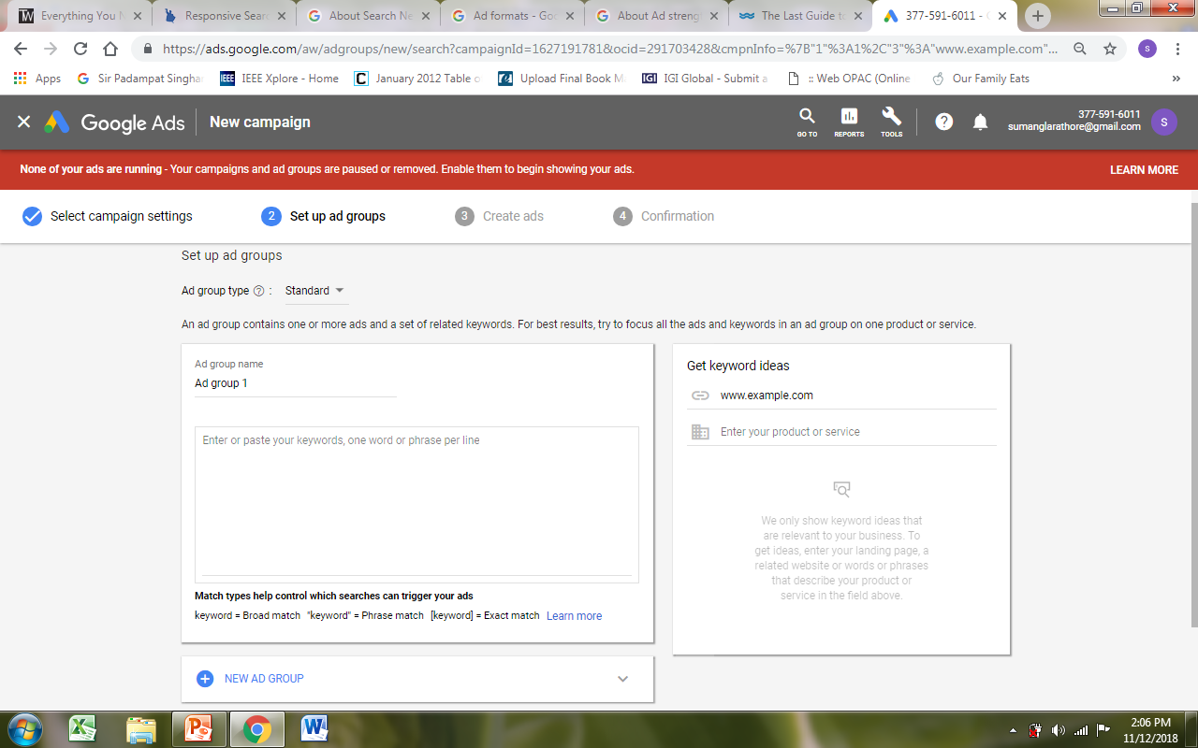
Ad-groups and keyword dashboard
Create Ad groups for your campaign by specifying a relevant name and keywords that are associated with that Ad Group.
Follow the keyword research guidelines discussed earlier to identify the keywords

Slide 21
Campaign set-up
Steps:
Select an appropriate goal for your campaign e.g. leads generation/sales/website traffic, etc.
Assign a suitable name to your campaign
Select the appropriate networks where you want to run your campaign e.g. search or display or both
Provide information such as start/end date for campaign, specific locations where it has to appear, languages and audience characteristics(demographics, interests, remarketing)
Assign a suitable budget and a bidding method for the campaign
Create very specific ad groups.
Create 3 or more ads per ad group, and optimize how they show.
Additional settings:
Add at least 4 different extension types to your account or campaigns.
Extensions are used to add call button, extra links, an address, or other extra information to an ad.
For example:
Sitelink extensions: Direct people to specific pages on your website—your store hours, a specific product, or more.
Callouts: Callouts give you more space to add text. When customers see your ads with callouts, they see a larger ad with more detailed information about your business, products, and services.
Structured snippets: Highlighting specific aspects of your products and services in your ads.

Slide 22
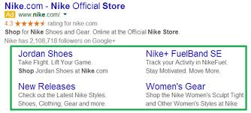
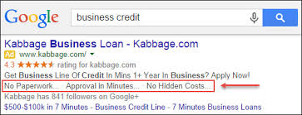
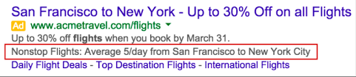
Sitelink extension
Callout extension
Structured snippet extension

Slide 23
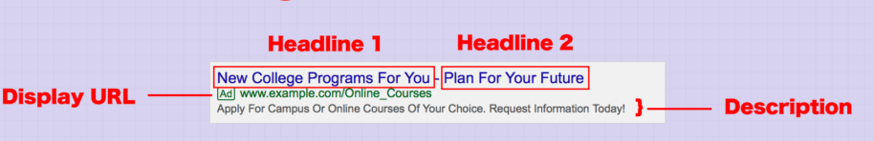
Ad-formats and guidelines
Search Ads on Google have three parts:
Headline text:
Can add up to 3 Headlines with 30 characters each.
Create a Heading using words that people may use in their Google search.
Headlines are separated by a vertical pipe ("|") and may show differently based on the device someone is using when they view your ad.
A display URL:
It shows your website address, usually in green.
Made up of the domain from your final URL and the text in the optional ”Path” fields, separated by a ‘/’.
Path fields are used to help people who see your ad get a better sense of where they’ll be taken when they click it e.g. www.example.com/online_courses
Description text:
Used to highlight details about your product or service.
Include a “call to action”—the action you want your customer to take

Slide 24
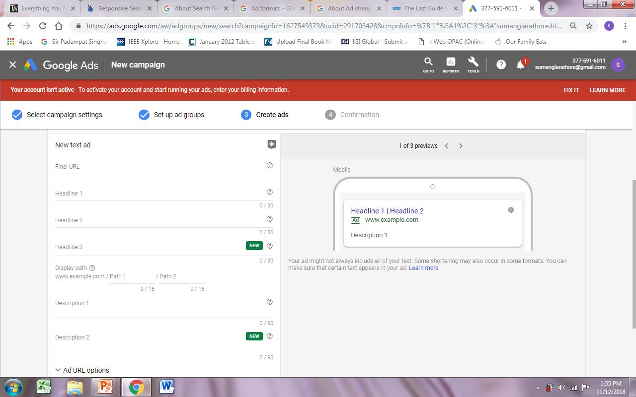

Slide 25
Ad-formats and guidelines
Ad extensions: Provide more information about your business, like its location, phone number, or additional deep links into your website, by adding extensions to your text ads.
Using special characters with your ads:
Most non-English characters, including tildes, umlauts, and cedillas, will appear correctly in your ads, including within the display URL.
Length Limits:
Field | Max length
Headline 1 | 30 characters
Headline 2 | 30 characters
Headline 3 | 30 characters
Description 1 | 90 characters
Description 2 | 90 characters
Path (2) | 15 characters each

Slide 26
Direct campaign vs branding campaign
Direct campaign
To generate immediate sales or traffic. Companies may use it to grow their customer base, launch a new product or clear out an excess of inventory.
An important part of direct response campaigns is a call to action, which gets customers to act immediately.
Branding Campaign
used by companies to build up a certain image for their brand. Some of the elements that companies focus on is the offering of high-quality service or affordable products. Generally display and video campaigns are considered to be more effective here.
To design a particular campaign, select the specific goal in the first step of creating a campaign in Google Ads.

Slide 27
Ad bidding
How the Ad Auction Works?
Takes place every single time someone enters a search query into Google.
To be entered into the ad auction, advertisers identify keywords they want to bid on, and state how much they are willing to spend (per click) to have their ads appear alongside results relating to those keywords.
If Google determines that the keywords you have bid on are contained within a user’s search query, your ads are entered into the ad auction.

Slide 28
Ad bidding
To win an auction, ad auction takes a variety of factors into account when determining the placement of ads on the SERP
The two main factors that Google evaluates as part of the ad auction process are:
Maximum bid: the maximum amount you have specified you are willing to pay for a click.
Quality Score of your ads: a metric based on the overall quality of your advertisement.

Slide 29
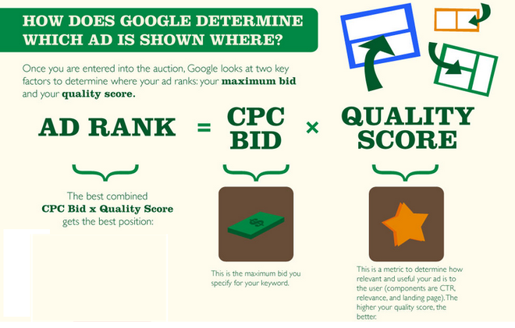

Slide 30
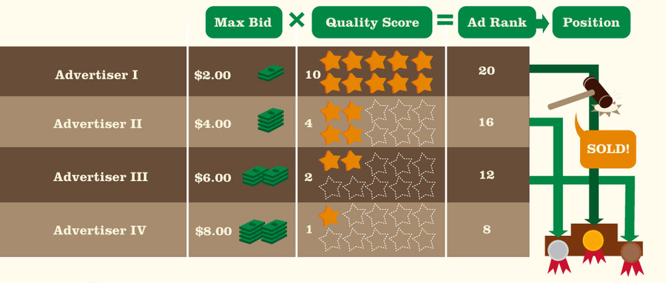
How to achieve higher quality scores?
High Quality Scores can help you achieve better ad position at lower costs, because Google favors ads that are highly relevant to user queries.

Slide 31
How to achieve higher quality scores?
Depends on following factors:
Your click-through rate (CTR).
The relevance of each keyword to its ad group.
Landing page quality and relevance.
The relevance of your ad text.
Your historical AdWords account performance.
Click-through rate is the most important component.
Indicates that your ads are relevant and helpful to users. Accordingly, Google rewards you with:
Higher ad rankings
Lower costs

Slide 32
Common issues related to search ads and their solutions
Missing ad group: Assign your ad to an ad group.
Missing keywords in ad group: Add keywords to your ad group. Your responsive search ad won’t serve without keywords.
Final URL is missing: Add a final URL to your ad.
Headlines/Descriptions are too similar: Approach your headlines and descriptions differently, and emphasize new aspects of what you’re selling or the different customers you’re appealing to. Adding more unique headlines and descriptions can increase your chances for better performance.
Headlines/Descriptions are too short: Provide enough details to catch the attention of your target customers.

Slide 33
References
https://support.google.com
https://www.wordstream.com/search-engine-marketing
https://www.square2marketing.com/blog/branding-vs-direct-response-which-marketing-strategy-is-right
https://www.wordstream.com/blog/ws/2017/05/02/adwords-account-structure-guide

